Slide 1
Exercise 3
Microscopy and Cellular Diversity

Slide 2
This exercise introduced the different types of microscopes used in our laboratory to study cells and cellular structure. You should know the parts of these microscopes and their functions, and the procedures for preparing wet mounts, focusing and viewing specimens, and proper care and storage of microscopes. You examined a variety of cell types, ranging from prokaryotic cells (cyanobacteria and bacteria) to eukaryotic cells (plant cells and animal cells). You should be able to recognize each of these cell types as well as any subcellular structures visible with the light microscopes. In addition you should be able to name bacterial types and identify Oscillatoria, Anabaena, and Gloeocapsa. You will be expected to be able to estimate the size of a cell or organism as seen through the microscope. Review the images on this page to test your knowledge.

Slide 3
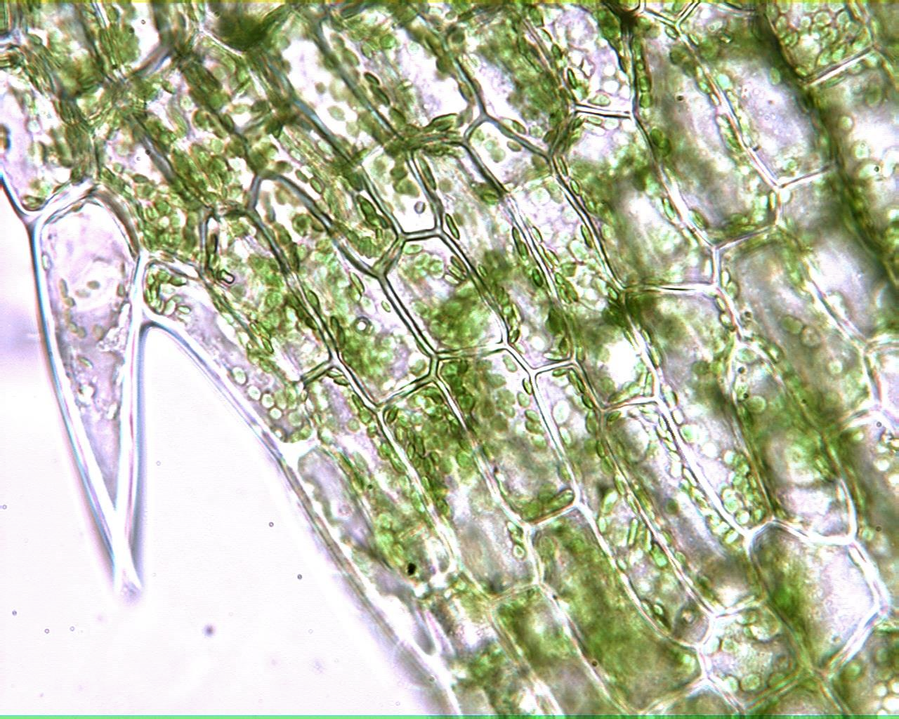
Elodea Leaf 400X

Slide 4
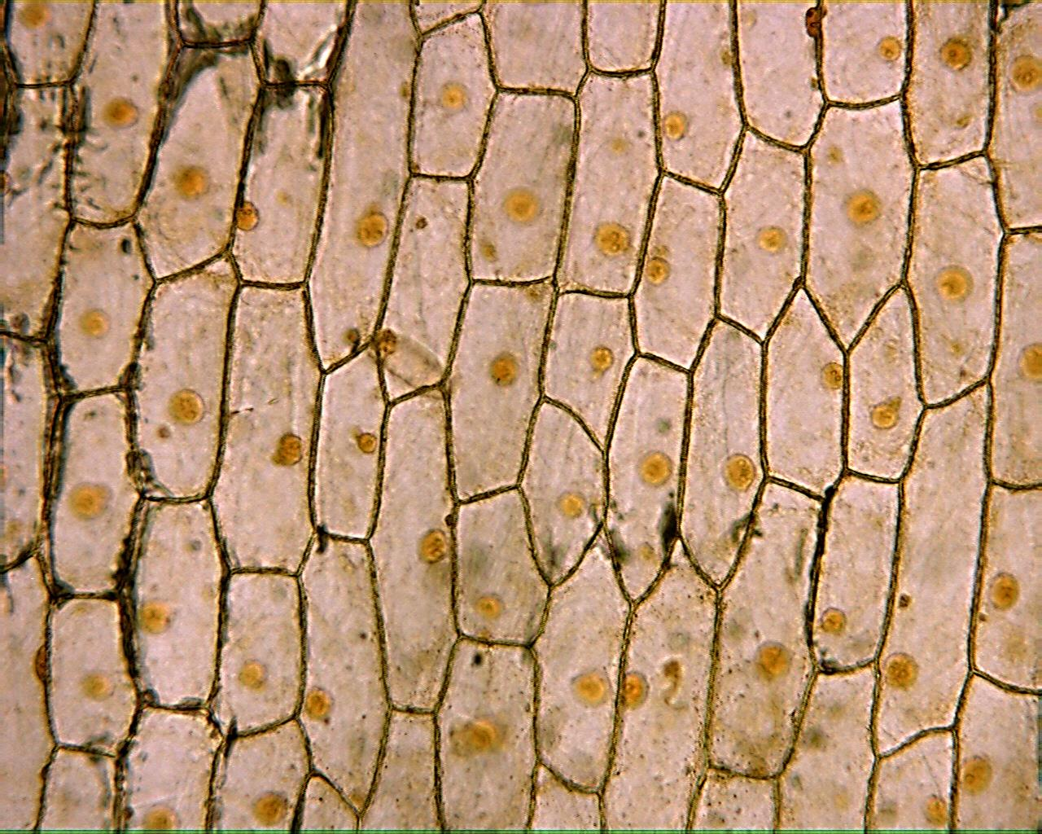
Onion Epidermis 100X

Slide 5
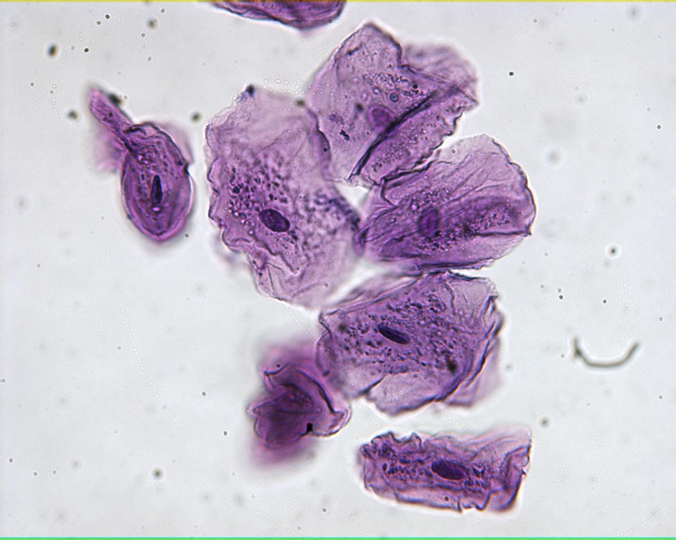
Human Epidermal Cells 100X

Slide 6
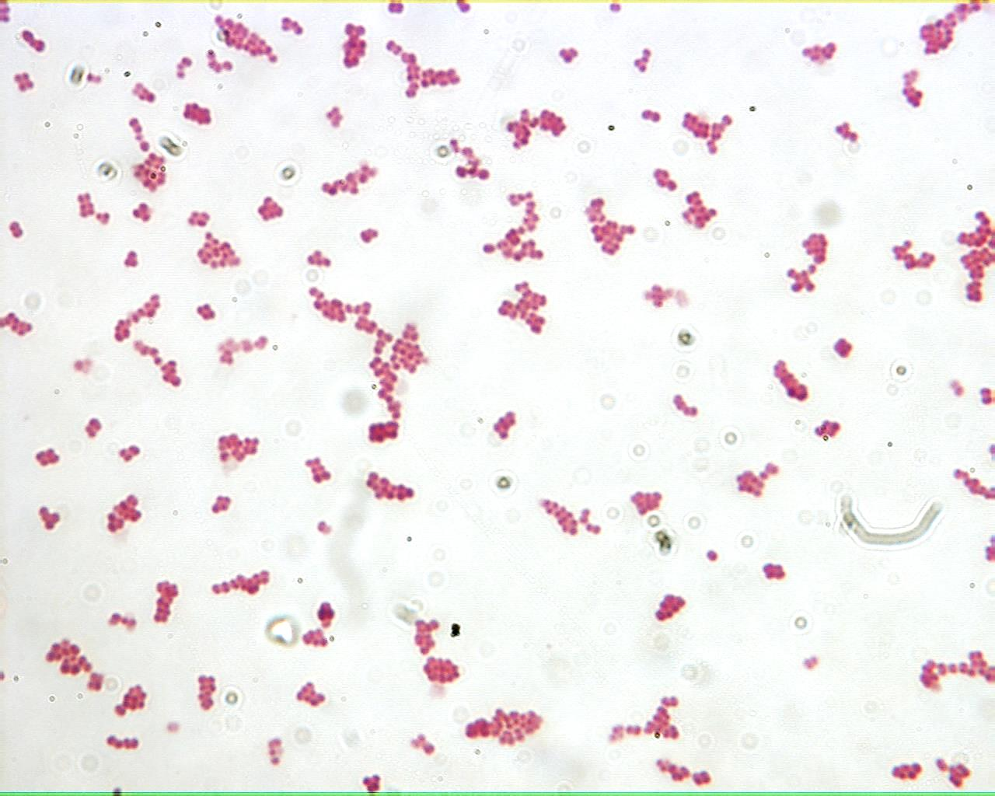
Bacterial Shape: Coccus 1000X

Slide 7
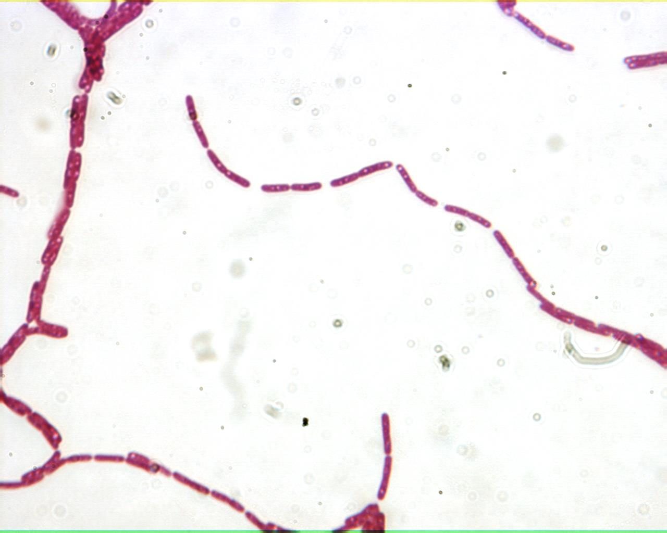
Bacterial Shape: Bacillus 1000X

Slide 8
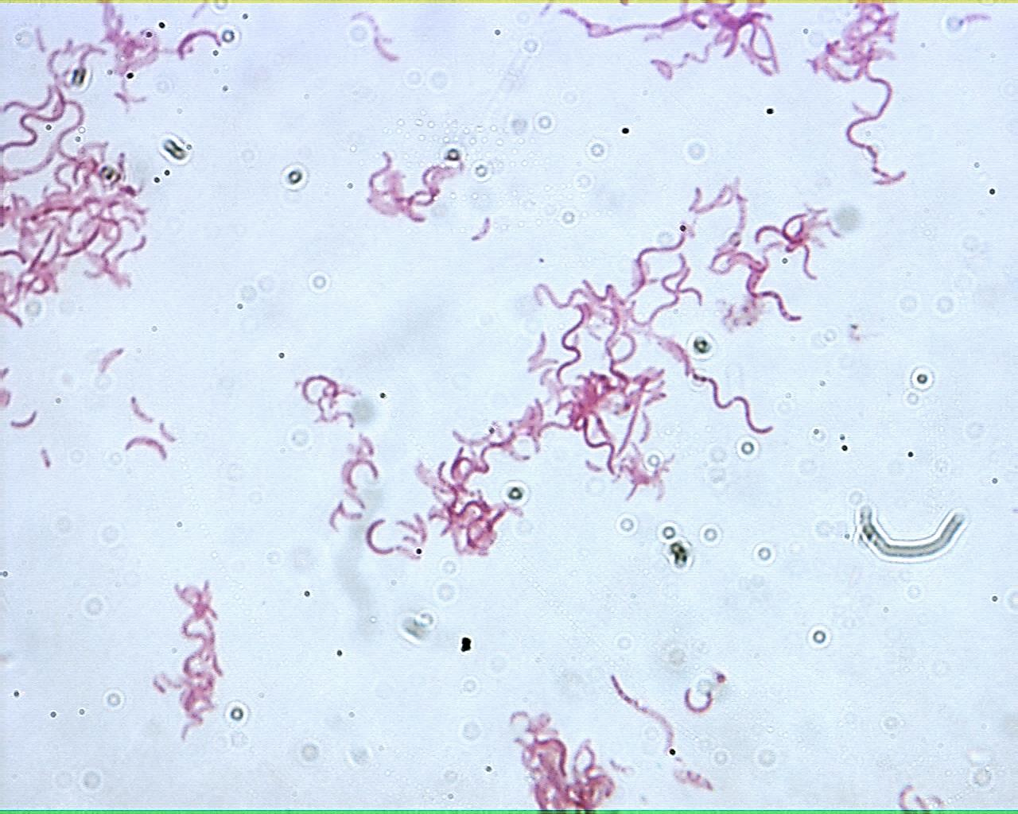
Bacterial Shape: Spirillum 1000X

Slide 9
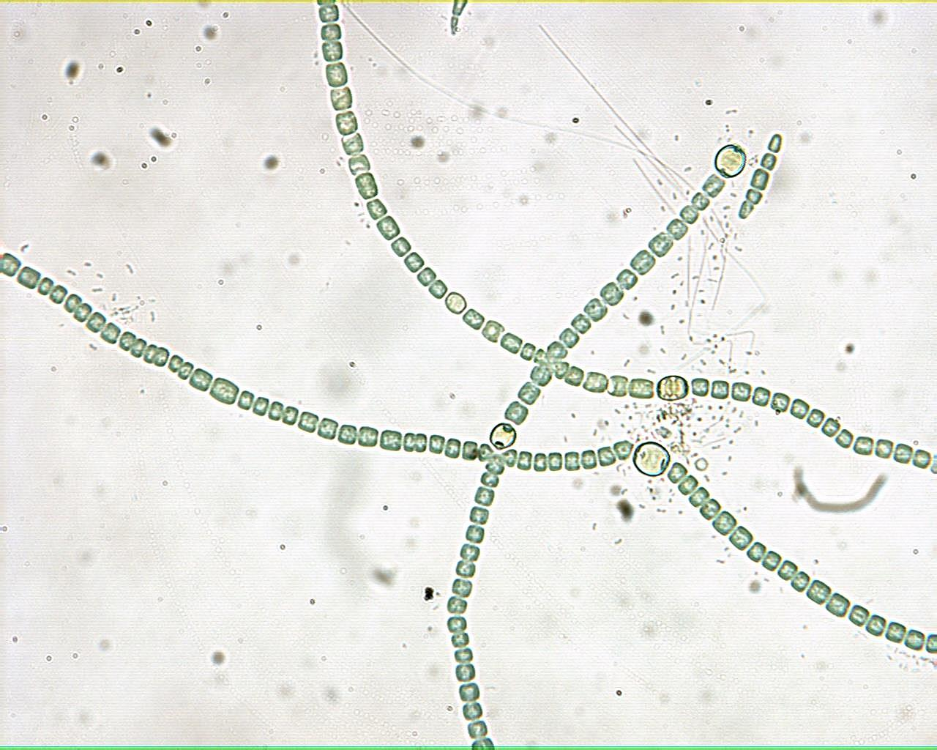
Anabaena 400X

Slide 10
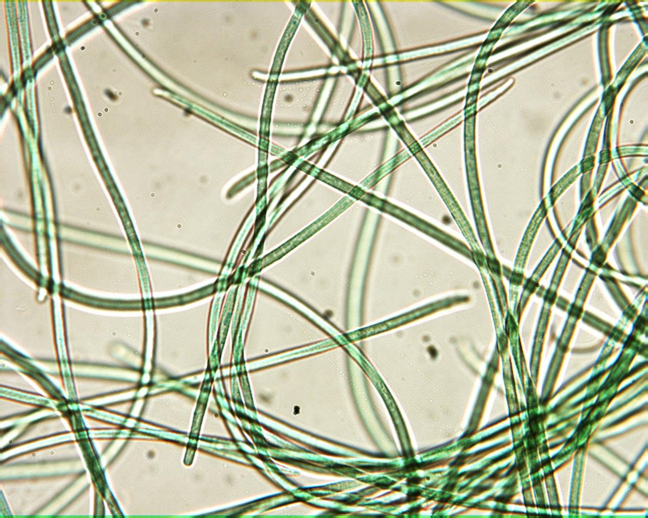
Oscillatoria 400X

Slide 11
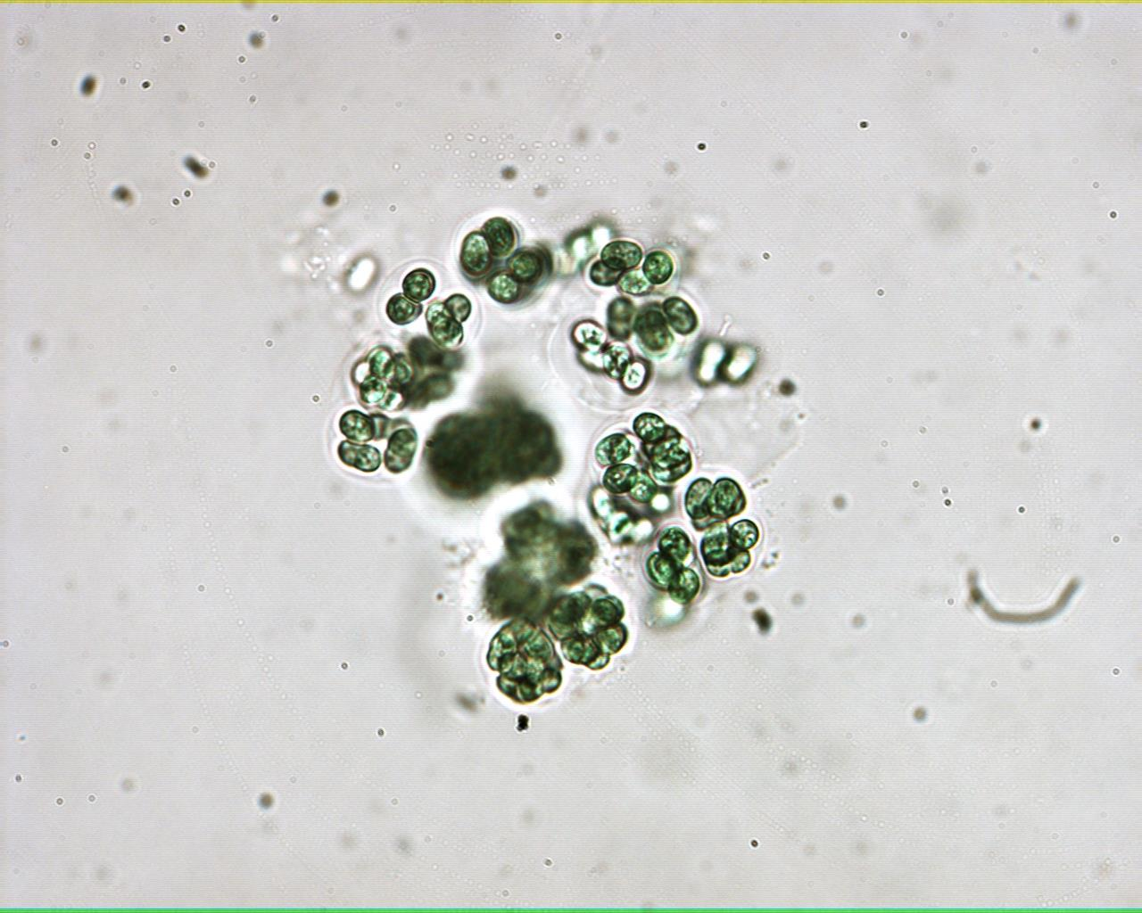
Gloeocapsa 400X

